Slide 1
FPGA Neural Network Hand Written Digit Recognition
鍾宇騫

Slide 2
DEMO VIDEO
Neural Network Architecture
Model Training
Model Accuracy
Implementation
Block Diagram
I/O
Fixed Point Computation
Parameter Storing
FSM & Loading data timing
FPGA resource usage
Defect
Accomplishment

Slide 3
DEMO VIDEO
https://www.youtube.com/watch?v=8pCeZvHnR6I&feature=youtu.be

Slide 4
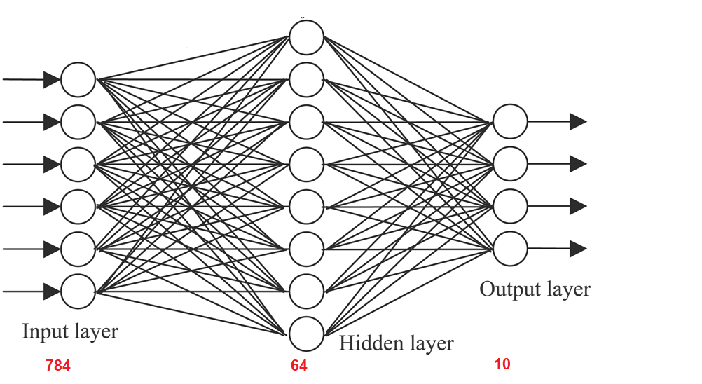
Neural Network Architecture

Slide 5
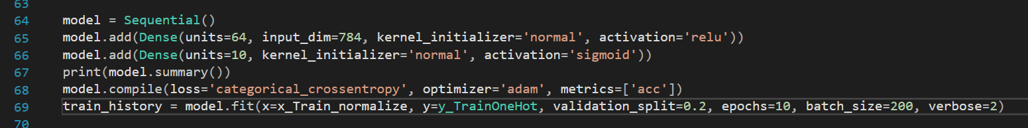
Model Training
Using Python with Keras and MNIST to train model by using 28 X 28 pixels data set

Slide 6
Model Accuracy
Python : 95%
Verilog Simulation : 90%
FPGA : 65%

Slide 7
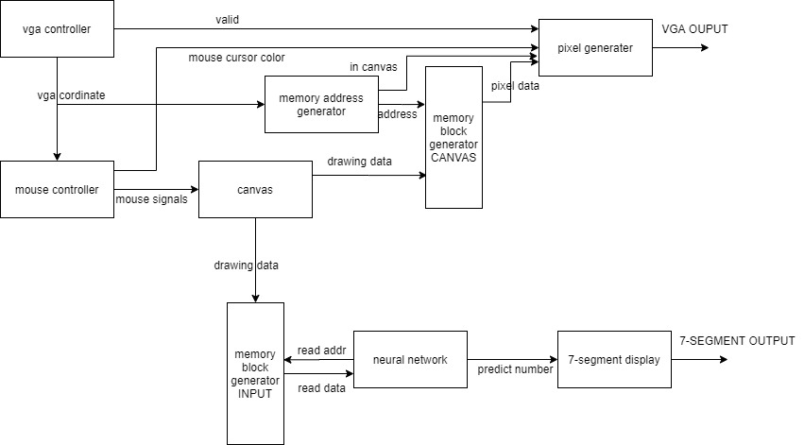
Block Diagram

Slide 8
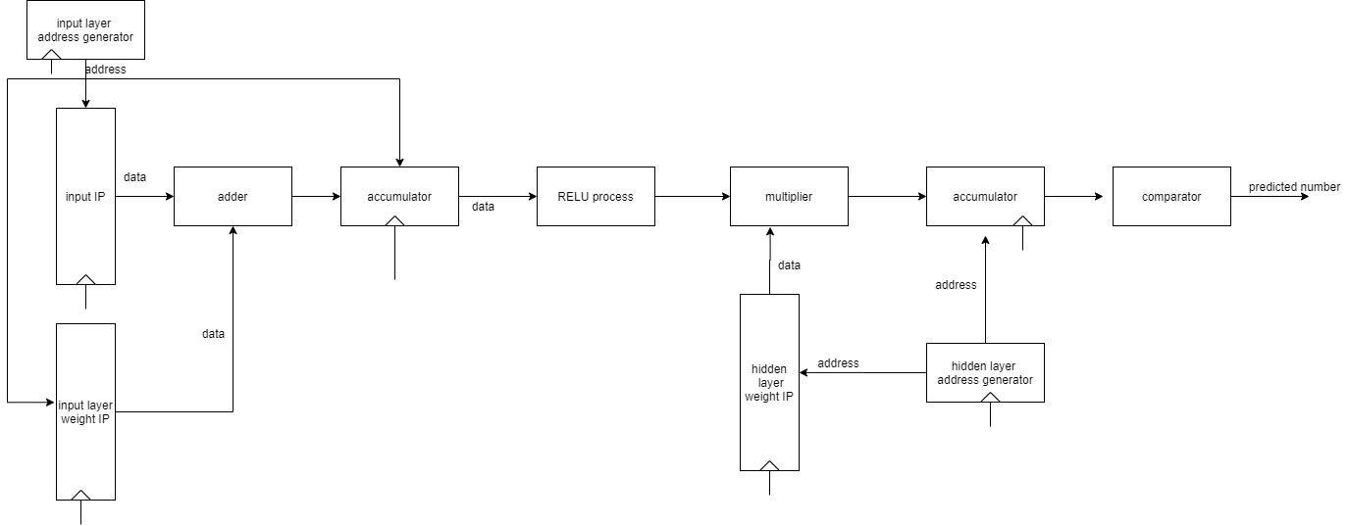
Neural Network block diagram

Slide 9
I / O
Input mouse drawing module is modified from 孫偉芳’s file: mouse.zip in iLMS
Output is 7-segment displaying predicted number on FPGA board

Slide 10
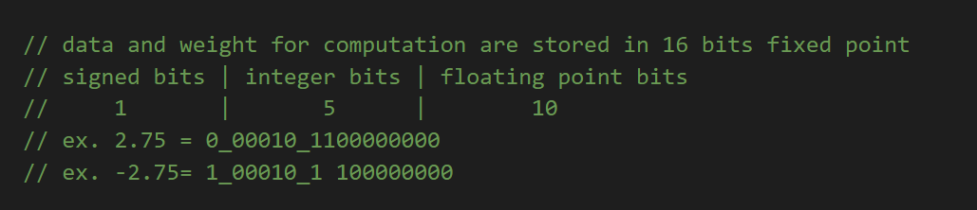
Fixed Point Computing
All the floating point used or generated in neural network are stored in fixed point form with customized adder and multiplier

Slide 11
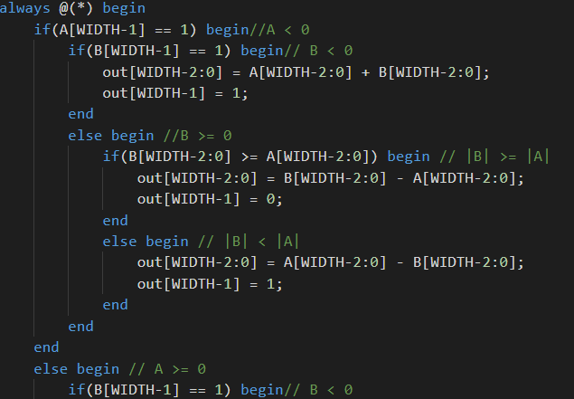
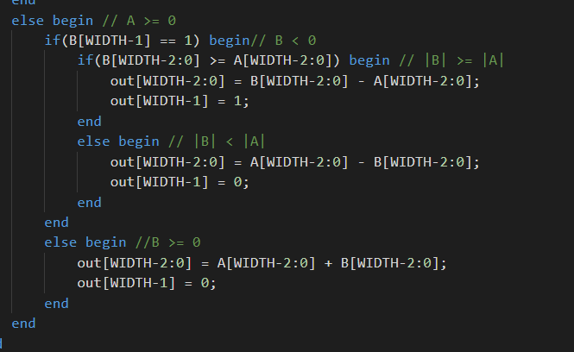
Fixed point adder

Slide 12
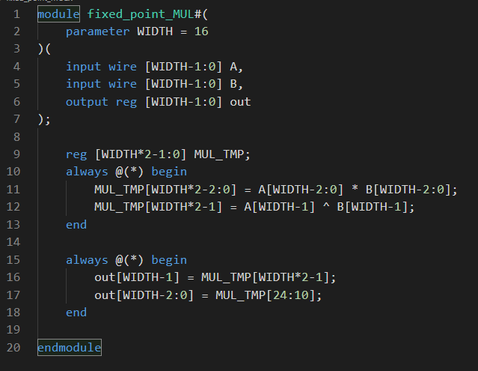
Fixed Point Multiplier

Slide 13
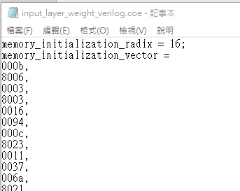
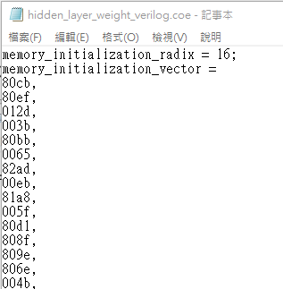
Parameter storing
Stored in memory block generator as .coe file generated by C++ code

Slide 14
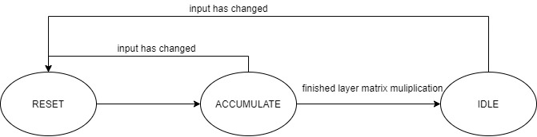
FSM : input layer to hidden layer
When input has changed, FSM will be set to RESET state for correct computation
Accumulate state will use (784+1)*10 clock cycles if it didn’t be reset

Slide 15
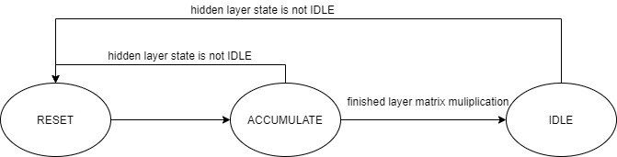
FSM: hidden layer to output layer
If hidden layer computing state is not IDLE, hidden layer state will be set to RESET state to wait the final result of hidden layer activation.

Slide 16
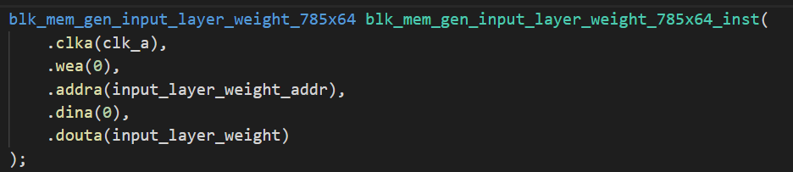
Loading data timing
Only load single address data in one cycle => all computation share same circuit

Slide 17
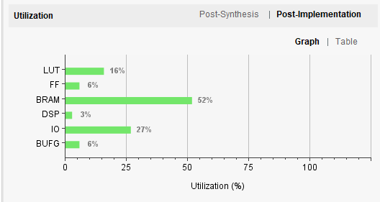
FPGA resource usage

Slide 18
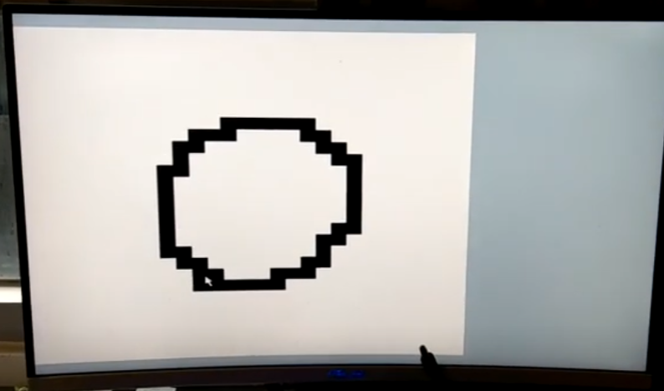
Defect
Imperfect Canvas system => low accuracy for prediction

Slide 19
Accomplishment
Using mouse module to implement hand written input
Compressed a 784 x 64 x 10 neural network parameters into FPGA board
Using block memory generator and double FSM to control computation

